Slide 1
Module 15: IP Static Routing
Instructor Materials
Switching, Routing, and Wireless Essentials v7.0
(SRWE)
Notes:
Cisco Networking Academy Program
Switching, Routing, and Wireless Essentials v7.0 (SRWE)
Module 15: IP Static Routing

Slide 2
Instructor Materials – Module 15 Planning Guide
This PowerPoint deck is divided in two parts:
Instructor Planning Guide
Information to help you become familiar with the module
Teaching aids
Instructor Class Presentation
Optional slides that you can use in the classroom
Begins on slide # 9
Note: Remove the Planning Guide from this presentation before sharing with anyone.
For additional help and resources go to the Instructor Home Page and Course Resources for this course. You also can visit the professional development site on netacad.com, the official Cisco Networking Academy Facebook page, or Instructor Only FB group.
Notes:
<number>

Slide 3
What to Expect in this Module
To facilitate learning, the following features within the GUI may be included in this module:
Feature | Description
Animations | Expose learners to new skills and concepts.
Videos | Expose learners to new skills and concepts.
Check Your Understanding(CYU) | Per topic online quiz to help learners gauge content understanding.
Interactive Activities | A variety of formats to help learners gauge content understanding.
Syntax Checker | Small simulations that expose learners to Cisco command line to practice configuration skills.
PT Activity | Simulation and modeling activities designed to explore, acquire, reinforce, and expand skills.

Slide 4
What to Expect in this Module (Cont.)
To facilitate learning, the following features may be included in this module:
Feature | Description
Hands-On Labs | Labs designed for working with physical equipment.
Class Activities | These are found on the Instructor Resources page. Class Activities are designed to facilitate learning, class discussion, and collaboration.
Module Quizzes | Self-assessments that integrate concepts and skills learned throughout the series of topics presented in the module.
Module Summary | Briefly recaps module content.

Slide 5
Check Your Understanding
Check Your Understanding activities are designed to let students quickly determine if they understand the content and can proceed, or if they need to review.
Check Your Understanding activities do not affect student grades.
There are no separate slides for these activities in the PPT. They are listed in the notes area of the slide that appears before these activities.
Notes:
<number>

Slide 6
Module 15: Activities
What activities are associated with this module?
Page # | Activity Type | Activity Name | Optional?
15.1.8 | Check Your Understanding | Static Routes | Recommended
15.2.8 | Syntax Checker | Configure Static Routes | Recommended
15.3.4 | Syntax Checker | Configure Default Static Routes | Recommended
15.4.4 | Syntax Checker | Configure Floating Static Route | Recommended
15.5.7 | Syntax Checker | Configure Static Host Routes | Recommended
15.6.1 | Packet Tracer | Configure IPv4 and IPv6 Static and Default Routes | Recommended
15.6.2 | Lab | Configure IPv4 and IPv6 Static and Default Routes | Recommended
Notes:
<number>

Slide 7
Module 15: Best Practices
Prior to teaching Module 15, the instructor should:
Review the activities and assessments for this module.
Try to include as many questions as possible to keep students engaged during classroom presentation.
Topic 15.1
Ask the students or have a class discussion
Why are static routes a necessity in modern networks?
What is the drawback to using static routes in your network?
Topic 15.2
Ask the students or have a class discussion
Have the students develop analogies to help explain the different types of static routes.
Have the students develop an analogy to illustrate the need for a fully specified static route.
Notes:
<number>

Slide 8
Module 15: Best Practices (Cont.)
Topic 15.3
Ask the students or have a class discussion
Is a default route the default or the last resort?
Have the students explain the significance of the 0-bit mask used with default routes.
Topic 15.4
Ask the students or have a class discussion
Is there value to a floating static route when the local router has only one path out of the network?
Topic 15.5
Ask the students or have a class discussion
What benefit do local host routes provide to the IOS?
Can you think of a situation where a static host route might be the tool you need to solve a routing problem?
Notes:
<number>

Slide 9
Module 15: IP Static Routing
Switching, Routing, and Wireless Essentials v7.0 (SRWE)
Notes:
Cisco Networking Academy Program
Switching, Routing, and Wireless Essentials v7.0 (SRWE)
Module 15: IP Static Routing

Slide 10
Module Objectives
Module Title: IP Static Routing
Module Objective: Configure IPv4 and IPv6 static routes.
Topic Title | Topic Objective
Static Routes | Describe the command syntax for static routes.
Configure IP Static Routes | Configure IPv4 and IPv6 static routes.
Configure IP Default Static Routes | Configure IPv4 and IPv6 default static routes.
Configure Floating Static Routes | Configure a floating static route to provide a backup connection.
Configure Static Host Routes | Configure IPv4 and IPv6 static host routes that direct traffic to a specific host.
Notes:
<number>
15- IP Static Routing
15.0 – Introduction
15.0.2 – What will I learn to do in this module?

Slide 11
15.1 Static Routes
Notes:
15 – IP Static Routing
15.1 – Static Routes

Slide 12
Static Routes Types of Static Routes
Static routes are commonly implemented on a network. This is true even when there is a dynamic routing protocol configured.
Static routes can be configured for IPv4 and IPv6. Both protocols support the following types of static routes:
Standard static route
Default static route
Floating static route
Summary static route
Static routes are configured using the ip route and ipv6 route global configuration commands.
Notes:
15 – IP Static Routing
15.1 – Static Routes
15.1.1 - Type of Static Routes

Slide 13
Static Routes Next-Hop Options
When configuring a static route, the next hop can be identified by an IP address, exit interface, or both. How the destination is specified creates one of the three following types of static route:
Next-hop route - Only the next-hop IP address is specified
Directly connected static route - Only the router exit interface is specified
Fully specified static route - The next-hop IP address and exit interface are specified
Notes:
15 – IP Static Routing
15.1 – Static Routes
15.1.2 - Next-Hop Options

Slide 14
Static Routes IPv4 Static Route Command
IPv4 static routes are configured using the following global configuration command:
Router(config)# ip route network-address subnet-mask { ip-address | exit-intf [ip-address]} [distance]
Note: Either the ip-address, exit-intf, or the ip-address and exit-intf parameters must be configured.
Notes:
15 – IP Static Routing
15.1 – Static Routes
15.1.3 - IPv4 Static Route Command

Slide 15
Static Routes IPv6 Static Route Command
IPv6 static routes are configured using the following global configuration command:
Router(config)# ipv6 route ipv6-prefix/prefix-length {ipv6-address | exit-intf [ipv6-address]} [distance]
Most of parameters are identical to the IPv4 version of the command.
Notes:
15 – IP Static Routing
15.1 – Static Routes
15.1.4 - IPv6 Static Route Command

Slide 16
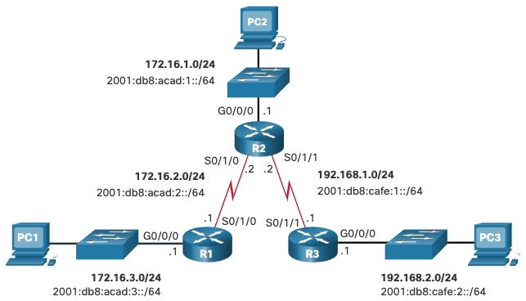
Static Routes Dual-Stack Topology
The figure shows a dual-stack network topology. Currently, no static routes are configured for either IPv4 or IPv6.
Notes:
15 – IP Static Routing
15.1 – Static Routes
15.1.5 - Dual-Stack Topology

Slide 17
Static Routes IPv4 Starting Routing Tables
Each router has entries only for directly connected networks and associated local addresses.
R1 can ping R2, but cannot ping the R3 LAN
R1# show ip route | begin Gateway
Gateway of last resort is not set
172.16.0.0/16 is variably subnetted, 4 subnets, 2 masks
C 172.16.2.0/24 is directly connected, Serial0/1/0
L 172.16.2.1/32 is directly connected, Serial0/1/0
C 172.16.3.0/24 is directly connected, GigabitEthernet0/0/0
L 172.16.3.1/32 is directly connected, GigabitEthernet0/0/0
R1#
R1# ping 172.16.2.2
Type escape sequence to abort. Sending 5, 100-byte ICMP Echos to 172.16.2.2, timeout is 2 seconds:
!!!!!
Success rate is 100 percent (5/5)
R1# ping 192.168.2.1
Type escape sequence to abort. Sending 5, 100-byte ICMP Echos to 192.168.2.1, timeout is 2 seconds: .....
Success rate is 0 percent (0/5)
Notes:
15 – IP Static Routing
15.1 – Static Routes
15.1.6 - IPv4 Starting Routing Tables

Slide 18
Static Routes IPv6 Starting Routing Tables
Each router has entries only for directly connected networks and associated local addresses.
R1 can ping R2, but cannot ping the R3 LAN.
R1# show ipv6 route | begin C
C 2001:DB8:ACAD:2::/64 [0/0]
via Serial0/1/0, directly connected
L 2001:DB8:ACAD:2::1/128 [0/0]
via Serial0/1/0, receive
C 2001:DB8:ACAD:3::/64 [0/0]
via GigabitEthernet0/0/0, directly connected
L 2001:DB8:ACAD:3::1/128 [0/0]
via GigabitEthernet0/0/0, receive
L FF00::/8 [0/0]
via Null0, receive
R1#
R1# ping 2001:db8:acad:2::2
Type escape sequence to abort.
Sending 5, 100-byte ICMP Echos to 2001:DB8:ACAD:2::2, timeout is 2 seconds:
!!!!!
Success rate is 100 percent (5/5), round-trip min/avg/max = 2/2/3 ms)
R1# ping 2001:DB8:cafe:2::1
Type escape sequence to abort.
Sending 5, 100-byte ICMP Echos to 2001:DB8:CAFE:2::1, timeout is 2 seconds:
% No valid route for destination
Success rate is 0 percent (0/1)
Notes:
15 – IP Static Routing
15.1 – Static Routes
15.1.7 - IPv6 Starting Routing Tables
15.1.8 - Check Your Understanding - Static Routes

Slide 19
15.2 Configure IP Static Routes
Notes:
15 – Static IP Routes
15.2 – Configure IP Static Routes

Slide 20
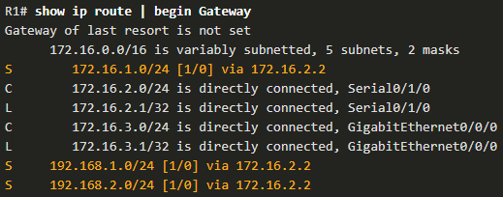
Configure IP Static Routes IPv4 Next-Hop Static Route
In a next-hop static route, only the next-hop IP address is specified. The exit interface is derived from the next hop. For example, three next-hop IPv4 static routes are configured on R1 using the IP address of the next hop, R2.
R1(config)# ip route 172.16.1.0 255.255.255.0 172.16.2.2
R1(config)# ip route 192.168.1.0 255.255.255.0 172.16.2.2
R1(config)# ip route 192.168.2.0 255.255.255.0 172.16.2.2
The resulting routing table entries on R1:
Notes:
15 – Static IP Routes
15.2 – Configure IP Static Routes
15.2.1 - IPv4 Next-Hop Static Route

Slide 21
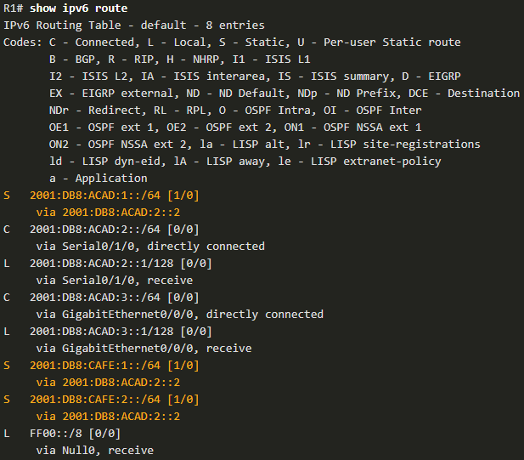
Configure IP Static Routes IPv6 Next-Hop Static Route
The commands to configure R1 with the IPv6 static routes to the three remote networks are as follows:
R1(config)# ipv6 unicast-routing
R1(config)# ipv6 route 2001:db8:acad:1::/64 2001:db8:acad:2::2
R1(config)# ipv6 route 2001:db8:cafe:1::/64 2001:db8:acad:2::2
R1(config)# ipv6 route 2001:db8:cafe:2::/64 2001:db8:acad:2::2
The routing table for R1 now has routes to the three remote IPv6 networks.
Notes:
15 – Static IP Routes
15.2 – Configure IP Static Routes
15.2.2 - IPv6 Next-Hop Static Route

Slide 22
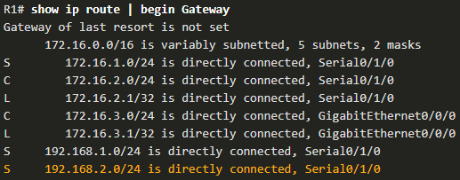
Configure IP Static Routes IPv4 Directly Connected Static Route
When configuring a static route, another option is to use the exit interface to specify the next-hop address. Three directly connected IPv4 static routes are configured on R1 using the exit interface.
Note: Using a next-hop address is generally recommended. Directly connected static routes should only be used with point-to-point serial interfaces.
R1(config)# ip route 172.16.1.0 255.255.255.0 s0/1/0
R1(config)# ip route 192.168.1.0 255.255.255.0 s0/1/0
R1(config)# ip route 192.168.2.0 255.255.255.0 s0/1/0
Notes:
15 – Static IP Routes
15.2 – Configure IP Static Routes
15.2.3 - IPv4 Directly Connected Static Route

Slide 23
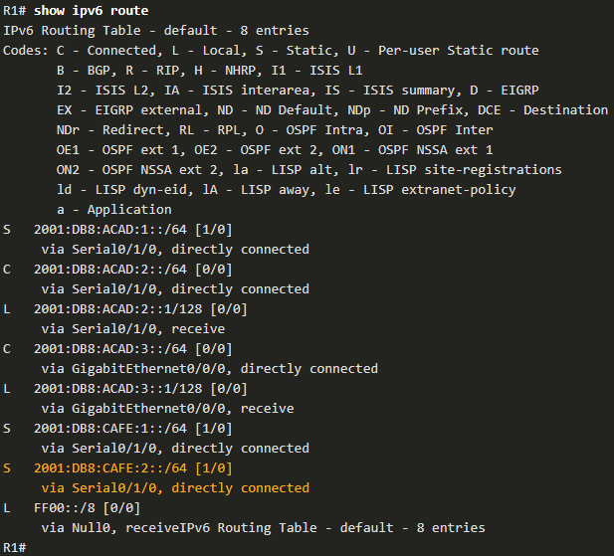
Configure IP Static Routes IPv6 Directly Connected Static Route
In the example, three directly connected IPv6 static routes are configured on R1 using the exit interface.
Note: Using a next-hop address is generally recommended. Directly connected static routes should only be used with point-to-point serial interfaces.
R1(config)# ipv6 route 2001:db8:acad:1::/64 s0/1/0
R1(config)# ipv6 route 2001:db8:cafe:1::/64 s0/1/0
R1(config)# ipv6 route 2001:db8:cafe:2::/64 s0/1/0
Notes:
15 – Static IP Routes
15.2 – Configure IP Static Routes
15.2.4 - IPv6 Directly Connected Static Route

Slide 24

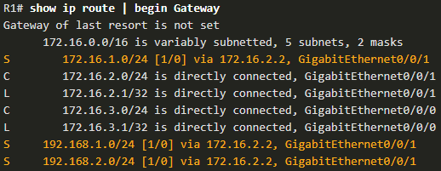
Configure IP Static Routes IPv4 Fully Specified Static Route
In a fully specified static route, both the exit interface and the next-hop IP address are specified. This form of static route is used when the exit interface is a multi-access interface and it is necessary to explicitly identify the next hop. The next hop must be directly connected to the specified exit interface. Using an exit interface is optional, however it is necessary to use a next-hop address.
It is recommended that when the exit interface is an Ethernet network, that the static route includes a next-hop address. You can also use a fully specified static route that includes both the exit interface and the next-hop address.
Notes:
15 – Static IP Routes
15.2 – Configure IP Static Routes
15.2.5 - IPv4 Fully Specified Static Route

Slide 25
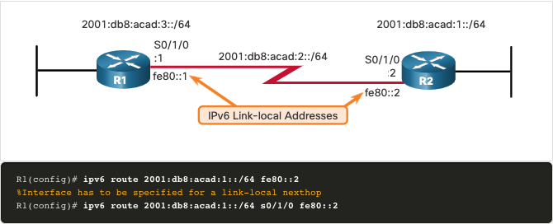
Configure IP Static Routes IPv6 Fully Specified Static Route
In a fully specified static route, both the exit interface and the next-hop IPV6 address are specified.
There is a situation in IPv6 when a fully specified static route must be used. If the IPv6 static route uses an IPv6 link-local address as the next-hop address, use a fully specified static route. The figure shows an example of a fully specified IPv6 static route using an IPv6 link-local address as the next-hop address.
Notes:
15 – Static IP Routes
15.2 – Configure IP Static Routes
15.2.6 - IPv6 Fully Specified Static Route

Slide 26

Configure IP Static Routes IPv6 Fully Specified Static Route (Cont.)
The reason a fully specified static route must be used is because IPv6 link-local addresses are not contained in the IPv6 routing table. Link-local addresses are only unique on a given link or network. The next-hop link-local address may be a valid address on multiple networks connected to the router. Therefore, it is necessary that the exit interface be included.
The following example shows the IPv6 routing table entry for this route. Notice that both the next-hop link-local address and the exit interface are included.
Notes:
15 – Static IP Routes
15.2 – Configure IP Static Routes
15.2.6 - IPv6 Fully Specified Static Route (Cont.)

Slide 27
Configure IP Static Routes Verify a Static Route
Along with show ip route, show ipv6 route, ping and traceroute, other useful commands to verify static routes include the following:
show ip route static
show ip route network
show running-config | section ip route
Replace ip with ipv6 for the IPv6 versions of the command.
Notes:
15 – Static IP Routes
15.2 – Configure IP Static Routes
15.2.7 - Verify a Static Route
15.2.8 - Syntax Checker - Configure Static Routes

Slide 28
15.3 Configure IP Default Static Routes
Notes:
15 – IP Static Routing
15.3 – Configure IP Default Static Routes

Slide 29
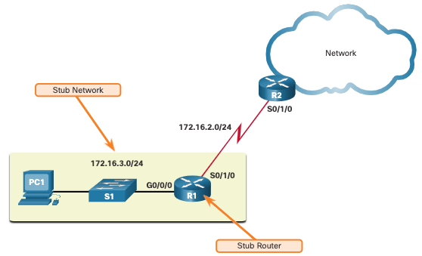
Configure IP Default Static Routes Default Static Route
A default route is a static route that matches all packets. A single default route represents any network that is not in the routing table.
Routers commonly use default routes that are either configured locally or learned from another router. The default route is used as the Gateway of Last Resort.
Default static routes are commonly used when connecting an edge router to a service provider network, or a stub router (a router with only one upstream neighbor router).
The figure shows a typical default static route scenario.
Notes:
15 – IP Static Routing
15.3 – Configure IP Default Static Routes
15.3.1 - Default Static Route

Slide 30
Configure IP Default Static Routes Default Static Route (Cont.)
IPv4 Default Static Route: The command syntax for an IPv4 default static route is similar to any other IPv4 static route, except that the network address is 0.0.0.0 and the subnet mask is 0.0.0.0. The 0.0.0.0 0.0.0.0 in the route will match any network address.
Note: An IPv4 default static route is commonly referred to as a quad-zero route.
The basic command syntax for an IPv4 default static route is as follows:
Router(config)# ip route 0.0.0.0 0.0.0.0 {ip-address | exit-intf}
IPv6 Default Static Route: The command syntax for an IPv6 default static route is similar to any other IPv6 static route, except that the ipv6-prefix/prefix-length is ::/0, which matches all routes.
The basic command syntax for an IPv6 default static route is as follows:
Router(config)# ipv6 route ::/0 {ipv6-address | exit-intf}
Notes:
15 – IP Static Routing
15.3 – Configure IP Default Static Routes
15.3.1 - Default Static Route (Cont.)

Slide 31
Configure IP Default Static Routes Configure a Default Static Route
The example shows an IPv4 default static route configured on R1. With the configuration shown in the example, any packets not matching more specific route entries are forwarded to R2 at 172.16.2.2.
R1(config)# ip route 0.0.0.0 0.0.0.0 172.16.2.2
An IPv6 default static route is configured in similar fashion. With this configuration any packets not matching more specific IPv6 route entries are forwarded to R2 at 2001:db8:acad:2::2
R1(config)# ipv6 route ::/0 2001:db8:acad:2::2
Notes:
15 – IP Static Routing
15.3 – Configure IP Default Static Routes
15.3.2 - Configure a Default Static Route

Slide 32
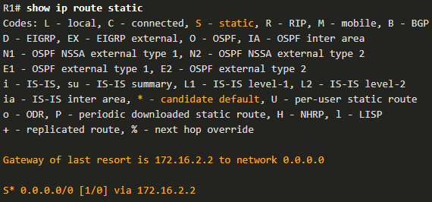
Configure IP Default Static Routes Verify a Default Static Route
The show ip route static command output from R1 displays the contents of the static routes in the routing table. Note the asterisk (*) next to the route with code ‘S’. The asterisk indicates that this static route is a candidate default route, which is why it is selected as the Gateway of Last Resort.
Notice that the static default route configuration uses the /0 mask for IPv4 default routes. Remember that the IPv4 subnet mask in a routing table determines how many bits must match between the destination IP address of the packet and the route in the routing table. A /0 mask indicates that none of the bits are required to match. As long as a more specific match does not exist, the default static route matches all packets.
Notes:
15 – IP Static Routing
15.3 – Configure IP Default Static Routes
15.3.3 - Verify a Default Static Route

Slide 33
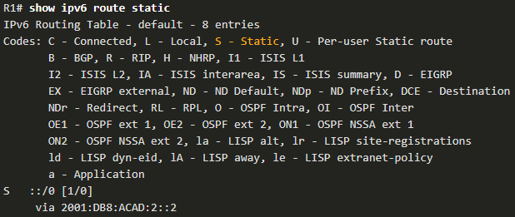
Configure IP Default Static Routes Verify a Default Static Route (Cont.)
This example shows the show ipv6 route static command output to display the contents of the routing table.
Notice that the static default route configuration uses the ::/0 prefix for IPv6 default routes. Remember that the IPv6 prefix-length in a routing table determines how many bits must match between the destination IP address of the packet and the route in the routing table. A ::/0 prefix indicates that none of the bits are required to match. As long as a more specific match does not exist, the default static route matches all packets.
Notes:
15 – IP Static Routing
15.3 – Configure IP Default Static Routes
15.3.3 - Verify a Default Static Route (Cont.)
15.3.4 - Syntax Checker - Configure Default Static Routes

Slide 34
15.4 Configure Floating Static Routes
Notes:
15 – IP Static Routing
15.4 – Configure Floating Static Routes

Slide 35
Configure Floating Static Routes Floating Static Routes
Another type of static route is a floating static route. Floating static routes are static routes that are used to provide a backup path to a primary static or dynamic route. The floating static route is only used when the primary route is not available.
To accomplish this, the floating static route is configured with a higher administrative distance than the primary route. The administrative distance represents the trustworthiness of a route. If multiple paths to the destination exist, the router will choose the path with the lowest administrative distance.
By default, static routes have an administrative distance of 1, making them preferable to routes learned from dynamic routing protocols.
The administrative distance of a static route can be increased to make the route less desirable than that of another static route or a route learned through a dynamic routing protocol. In this way, the static route “floats” and is not used when the route with the better administrative distance is active.
Notes:
15 – IP Static Routing
15.4 – Configure Floating Static Routes
15.4.1 - Floating Static Routes

Slide 36
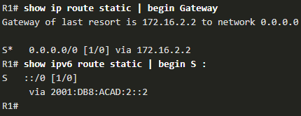
Configure Floating Static Routes Configure IPv4 and IPv6 Floating Static Routes
The commands to configure default and floating IP default routes are as follows:
The show ip route and show ipv6 route output verifies that the default routes to R2 are installed in the routing table. Note that the IPv4 floating static route to R3 is not present in the routing table.
R1(config)# ip route 0.0.0.0 0.0.0.0 172.16.2.2
R1(config)# ip route 0.0.0.0 0.0.0.0 10.10.10.2 5
R1(config)# ipv6 route ::/0 2001:db8:acad:2::2
R1(config)# ipv6 route ::/0 2001:db8:feed:10::2 5
Notes:
15 – IP Static Routing
15.4 – Configure Floating Static Routes
15.4.2 - Configure IPv4 and IPv6 Floating Static Routes

Slide 37
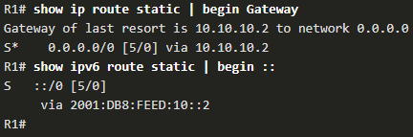
Configure Floating Static Routes Test the Floating Static Routes
What would happen if R2 failed? To simulate this, R2 shuts down both of its serial interfaces.
R1 automatically generates syslog messages for the link going down.
A look at R1’s routing table would show the secondary route being used.
Notes:
15 – IP Static Routing
15.4 – Configure Floating Static Routes
15.4.3 - Test the Floating Static Routes
15.4.4 - Syntax Checker - Configure Floating Static Route

Slide 38
15.5 Configure Static Host Routes
Notes:
15 – IP Static Routing
15.5 - Configure Static Host Routes

Slide 39
Configure Static Host Routes Host Routes
A host route is an IPv4 address with a 32-bit mask, or an IPv6 address with a 128-bit mask. The following shows the three ways a host route can be added to the routing table:
Automatically installed when an IP address is configured on the router
Configured as a static host route
Host route automatically obtained through other methods (discussed in later courses)
Notes:
15 – IP Static Routing
15.5 - Configure Static Host Routes
15.5.1 - Host Routes

Slide 40
Configure Static Host Routes Automatically Installed Host Routes
Cisco IOS automatically installs a host route, also known as a local host route, when an interface address is configured on the router. A host route allows for a more efficient process for packets that are directed to the router itself, rather than for packet forwarding.
This is in addition to the connected route, designated with a C in the routing table for the network address of the interface.
The local routes are marked with L in the output of the routing table.
Notes:
15 – IP Static Routing
15.5 - Configure Static Host Routes
15.5.2- Automatically Installed Host Routes

Slide 41
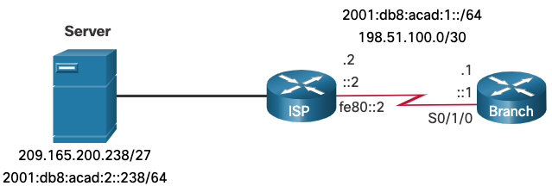
Configure Static Host Routes Static Host Routes
A host route can be a manually configured static route to direct traffic to a specific destination device, such as the server shown in the figure. The static route uses a destination IP address and a 255.255.255.255 (/32) mask for IPv4 host routes, and a /128 prefix length for IPv6 host routes.
Notes:
15 – IP Static Routing
15.5 - Configure Static Host Routes
15.5.3- Static Host Routes

Slide 42
Configure Static Host Routes Configure Static Host Routes
The example shows the IPv4 and IPv6 static host route configuration on the Branch router to access the server.
Branch(config)# ip route 209.165.200.238 255.255.255.255 198.51.100.2
Branch(config)# ipv6 route 2001:db8:acad:2::238/128 2001:db8:acad:1::2
Branch(config)# exit
Branch#
Notes:
15 – IP Static Routing
15.5 - Configure Static Host Routes
15.5.4 - Configure Static Host Routes

Slide 43
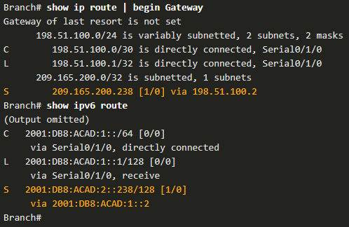
Configure Static Host Routes Verify Static Host Routes
A review of both the IPv4 and IPv6 route tables verifies that the routes are active.
Notes:
15 – IP Static Routing
15.5 - Configure Static Host Routes
15.5.5 - Verify Static Host Routes

Slide 44
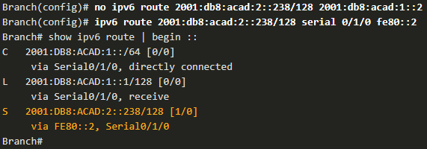
Configure Static Host Routes Configure IPv6 Static Host Route with Link-Local Next-Hop
For IPv6 static routes, the next-hop address can be the link-local address of the adjacent router. However, you must specify an interface type and an interface number when using a link-local address as the next hop, as shown in the example. First, the original IPv6 static host route is removed, then a fully specified route configured with the IPv6 address of the server and the IPv6 link-local address of the ISP router.
Notes:
15 – IP Static Routing
15.5 - Configure Static Host Routes
15.5.6 - Configure IPv6 Static Host Route with Link-Local Next-Hop
15.5.7 - Syntax Checker - Configure Static Host Routes

Slide 45
15.6 Module Practice and Quiz
Notes:
15 - IP Static Routing
15.6 - Module Practice and Quiz

Slide 46
Module Practice and Quiz Packet Tracer – Configure IPv4 and IPv6 Static and Default Routes
In this Packet Tracer, you will do the following:
Configure IPv4 Static and floating static default routers
Configure IPv6 static and floating static default routes
ConfigureIPv4 static and floating static routes to internal LANs
Configure IPv6 static and floating static routes to the internal LANS
Configure IPv4 host routes
Configure IPv6 host routes
Notes:
15 - IP Static Routing
15.6 - Module Practice and Quiz
15.6.1 - Packet Tracer - Configure IPv4 and IPv6 Static and Default Routes

Slide 47
Module Practice and Quiz Lab - Configure IPv4 and IPv6 Static and Default Routes
In this lab, you will complete the following objectives:
Build the Network and Configure Basic Device Settings
Configure and Verify IP and IPv6 Addressing on R1 and R2
Configure and Verify Static and Default Routing for IPv4 on R1 and R2
Configure and Verify Static and Default Routing for IPv6 on R1 and R2
Notes:
15 - IP Static Routing
15.6 - Module Practice and Quiz
15.6.2 - Lab- Configure IPv4 and IPv6 Static and Default Routes

Slide 48
Module Practice and Quiz What Did I Learn In This Module?
Static routes can be configured for IPv4 and IPv6. Both protocols support the following types of static routes: standard static route, default static route, floating static route, and summary static route.
When configuring a static route, the next hop can be identified by an IP address, exit interface, or both. How the destination is specified creates one of the three following types of static route: next-hop, directly connected, and fully specified.
IPv4 static routes are configured using the following global configuration command: ip route network-address subnet-mask { ip-address | exit-intf [ip=address] } [distance].
IPv6 static routes are configured using the following global configuration command: ipv6 route ipv6-prefix/prefix-length { ipv6-address | exit-intf [ipv6-address]} [distance].
In a next-hop static route, only the next-hop IP address is specified. The exit interface is derived from the next hop.
When configuring a static route, another option is to use the exit interface to specify the next-hop address. Directly connected static routes should only be used with point-to-point serial interfaces.
In a fully specified static route, both the exit interface and the next-hop IP address are specified. This form of static route is used when the exit interface is a multi-access interface and it is necessary to explicitly identify the next hop. The next hop must be directly connected to the specified exit interface.
In a fully specified IPv6 static route, both the exit interface and the next-hop IPv6 address are specified.
Notes:
15 - IP Static Routing
15.6 - Module Practice and Quiz
15.6.2 - What Did I Learn In This Module?

Slide 49
Module Practice and Quiz What Did I Learn In This Module? (Cont.)
A default route is a static route that matches all packets.
Default static routes are commonly used when connecting an edge router to a service provider network, and a stub router.
The command syntax for an IPv4 default static route is similar to any other IPv4 static route, except that the network address is 0.0.0.0 and the subnet mask is 0.0.0.0.
The command syntax for an IPv6 default static route is similar to any other IPv6 static route, except that the ipv6-prefix/prefix-length is ::/0, which matches all routes.
Floating static routes are static routes that are used to provide a backup path to a primary static or dynamic route in the event of a link failure.
The floating static route is configured with a higher administrative distance than the primary route. By default, static routes have an administrative distance of 1, making them preferable to routes learned from dynamic routing protocols.
IP floating static routes are configured by using the distance argument to specify an administrative distance.
A host route is an IPv4 address with a 32-bit mask or an IPv6 address with a 128-bit mask.
Notes:
15 - IP Static Routing
15.6 - Module Practice and Quiz
15.6.2 - What Did I Learn In This Module? (Cont.)

Slide 50
Module Practice and Quiz What Did I Learn In This Module? (Cont.)
There are three ways a host route can be added to the routing table: automatically installed when an IP address is configured on the router, configured as a static host route, or automatically obtained through other methods not covered in this module.
Cisco IOS automatically installs a host route, also known as a local host route, when an interface address is configured on the router.
A host route can be a manually configured static route to direct traffic to a specific destination device.
For IPv6 static routes, the next-hop address can be the link-local address of the adjacent router; however, you must specify an interface type and an interface number when using a link-local address as the next hop. To do this, the original IPv6 static host route is removed, then a fully specified route is configured with the IPv6 address of the server and the IPv6 link-local address of the ISP router.
Notes:
15 - IP Static Routing
15.6 - Module Practice and Quiz
15.6.2 - What Did I Learn In This Module?
15.6.3 - Module Quiz - IP Static Routing

Slide 51
Module 15: IP Static Routing New Terms and Commands
static route
default static route
floating static route
summary static route
next-hop route
directly connected static route
Fully specified static route
ip route network-address subnet-mask { ip-address | exit-intf [ip-address]} [distance]
ipv6 route ipv6-prefix/prefix-length {ipv6-address | exit-intf [ipv6-address]} [distance]
show ip route static
show ipv6 route static
quad-zero route
ip route 0.0.0.0 0.0.0.0 {ip-address | exit-intf}
ipv6 route ::/0 {ipv6-address | exit-intf}
host route
local host route
static host route

